Slide 1

Philosophy of Service Plenary Session
Dr. Stacy Welcome, Dean of Student Services, Central College
Dr. Rima Adil, Dean of Student Services, Northwest College
Dr. Chassity Holliman-Douglas, AVC Special Programs and Success
Notes:
Why is it important to have a service philosophy?

Slide 2
Purpose of a Philosophy of Service
A customer service philosophy:
Guides our approach to how we interact with our customers (students), work with one another, and resolve support issues that students encounter.
Keeps us focused on our mission, values, beliefs, and the experiences we hold as members of Student Services at HCC.
Foundation for effective, consistent, and meaningful service provided across Student Services.
When done right, our service philosophy will aid in student retention and success.

Slide 3
Mission of Houston Community College
Houston Community College is an open-admission, public institution of higher education offering a high-quality, affordable education for academic advancement, workforce training, career development, and lifelong learning to prepare individuals in our diverse communities for life and work in a global and technological society.
Our Shared Values
1. Commitment to Collaborate.
2. Devotion to service – We are unwavering in our commitment to serve our students and our community. By our willingness to adopt a serve-others-first mentality and approach to our work, we are able to live up to and surpass the expectations of our constituents and each other. By putting service first, we ensure the best experience for those we serve and those who choose to be part of HCC.
3. Empower to trust.
4. Impassion to learn.
5. Drive to innovate.
Notes:
Nithy’s slide

Slide 4
Who are our students?
• 35% primary child caregiver
• 64% dependent caregiver
• 60% food insecurities
• 46% report mental health issues
• 74% PT work while attending college
• 35% of students' language is not English
• 47% first generation
Notes:
Why is it important to highlight the students we serve?
Helps us to better understand who they are, what their needs might be, and how we can respond to provide support.

Slide 5
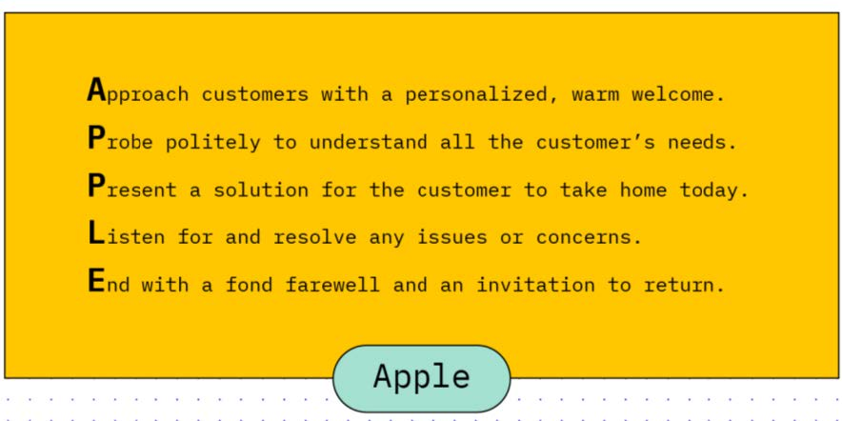

Examples of Service Philosophies
Apple
Lego
Notes:
Apple Question: What makes Apple’s customer service philosophy so great?
Possible Answers: personalization, understanding needs, present solutions, understand issues, and an invite to return.
LEGO’s customer service philosophy is succinct and successful. “Only the best is good enough” applies not only to their product but to how they deal with customers. “The best” is their baseline. Nothing else suffices.

Slide 6
In-Service
Reflections Questions
Notes:
Mentimeter Questions – to help us think about service – how we define it and what we value in service.

Slide 7
Small Group Discussion Questions
Consider your customer service experiences
What have you learned from your experiences?
How have they shaped your understanding of service?
Consider both positive and negative experiences, what did you gleaned from each?
Notes:
Need a Scribe to jot notes on the poster board.
Need someone at the end to report out.

Slide 8
Small Group Discussion Questions
What are your goals for service?
  Determine what you hope to achieve through your service.
  How do you want the person you’re serving to feel?
  Are you seeking to help colleagues, support students, build relationships, or develop new skills?
Notes:
Understanding your goals can help you focus your efforts and evaluate your progress.

Slide 9
Articulate A Philosophy of Service
Write the vision, Make it plain!
Based on your reflections, the HCC Mission and Values, and the students we serve work with your small group to articulate a philosophy of service.

Slide 10
Philosophy of Service for each College/ Division
Notes:
Share reflections from how your customer service experiences in your group, shape how you provide service.
What were some of the goals of service your group identified?
Let’s hear your philosophy.

Slide 11
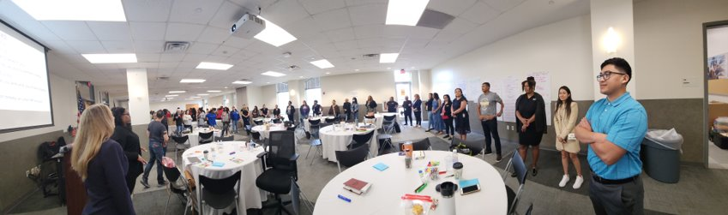
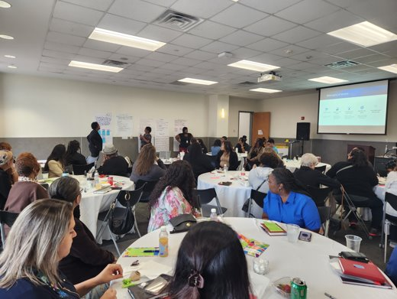
All student service areas will provide personalized support and guidance to all students, staff, and faculty, with empathy and compassion, that will lead to equitable removal of barriers to student success and help them reach their goals.
Philosophy of Service
District Student Services Divisions
Student Engagement
Enrollment Management

Slide 12
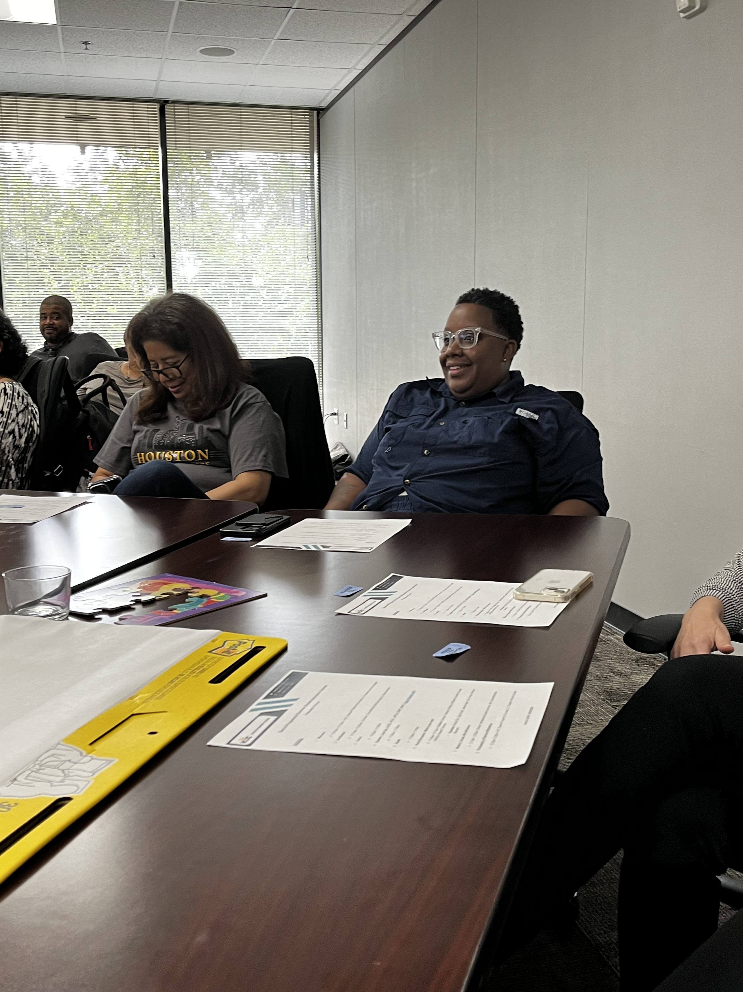
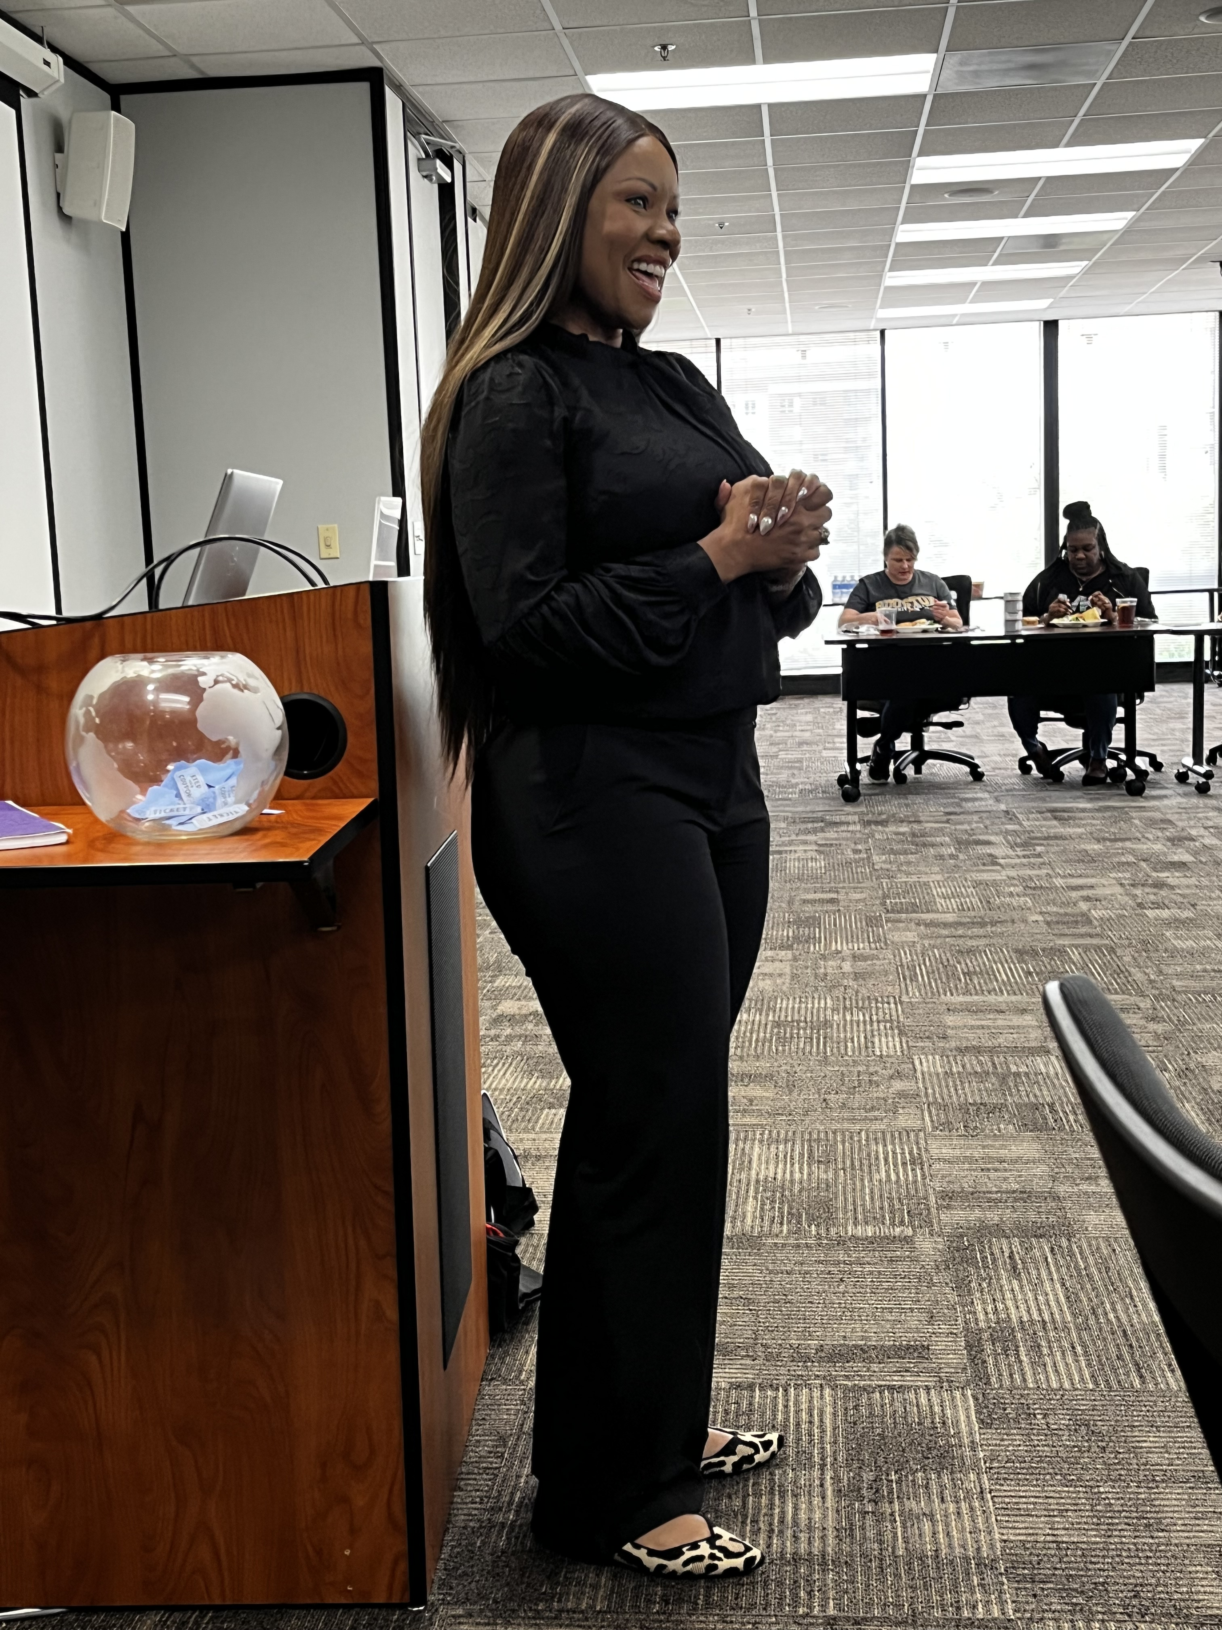
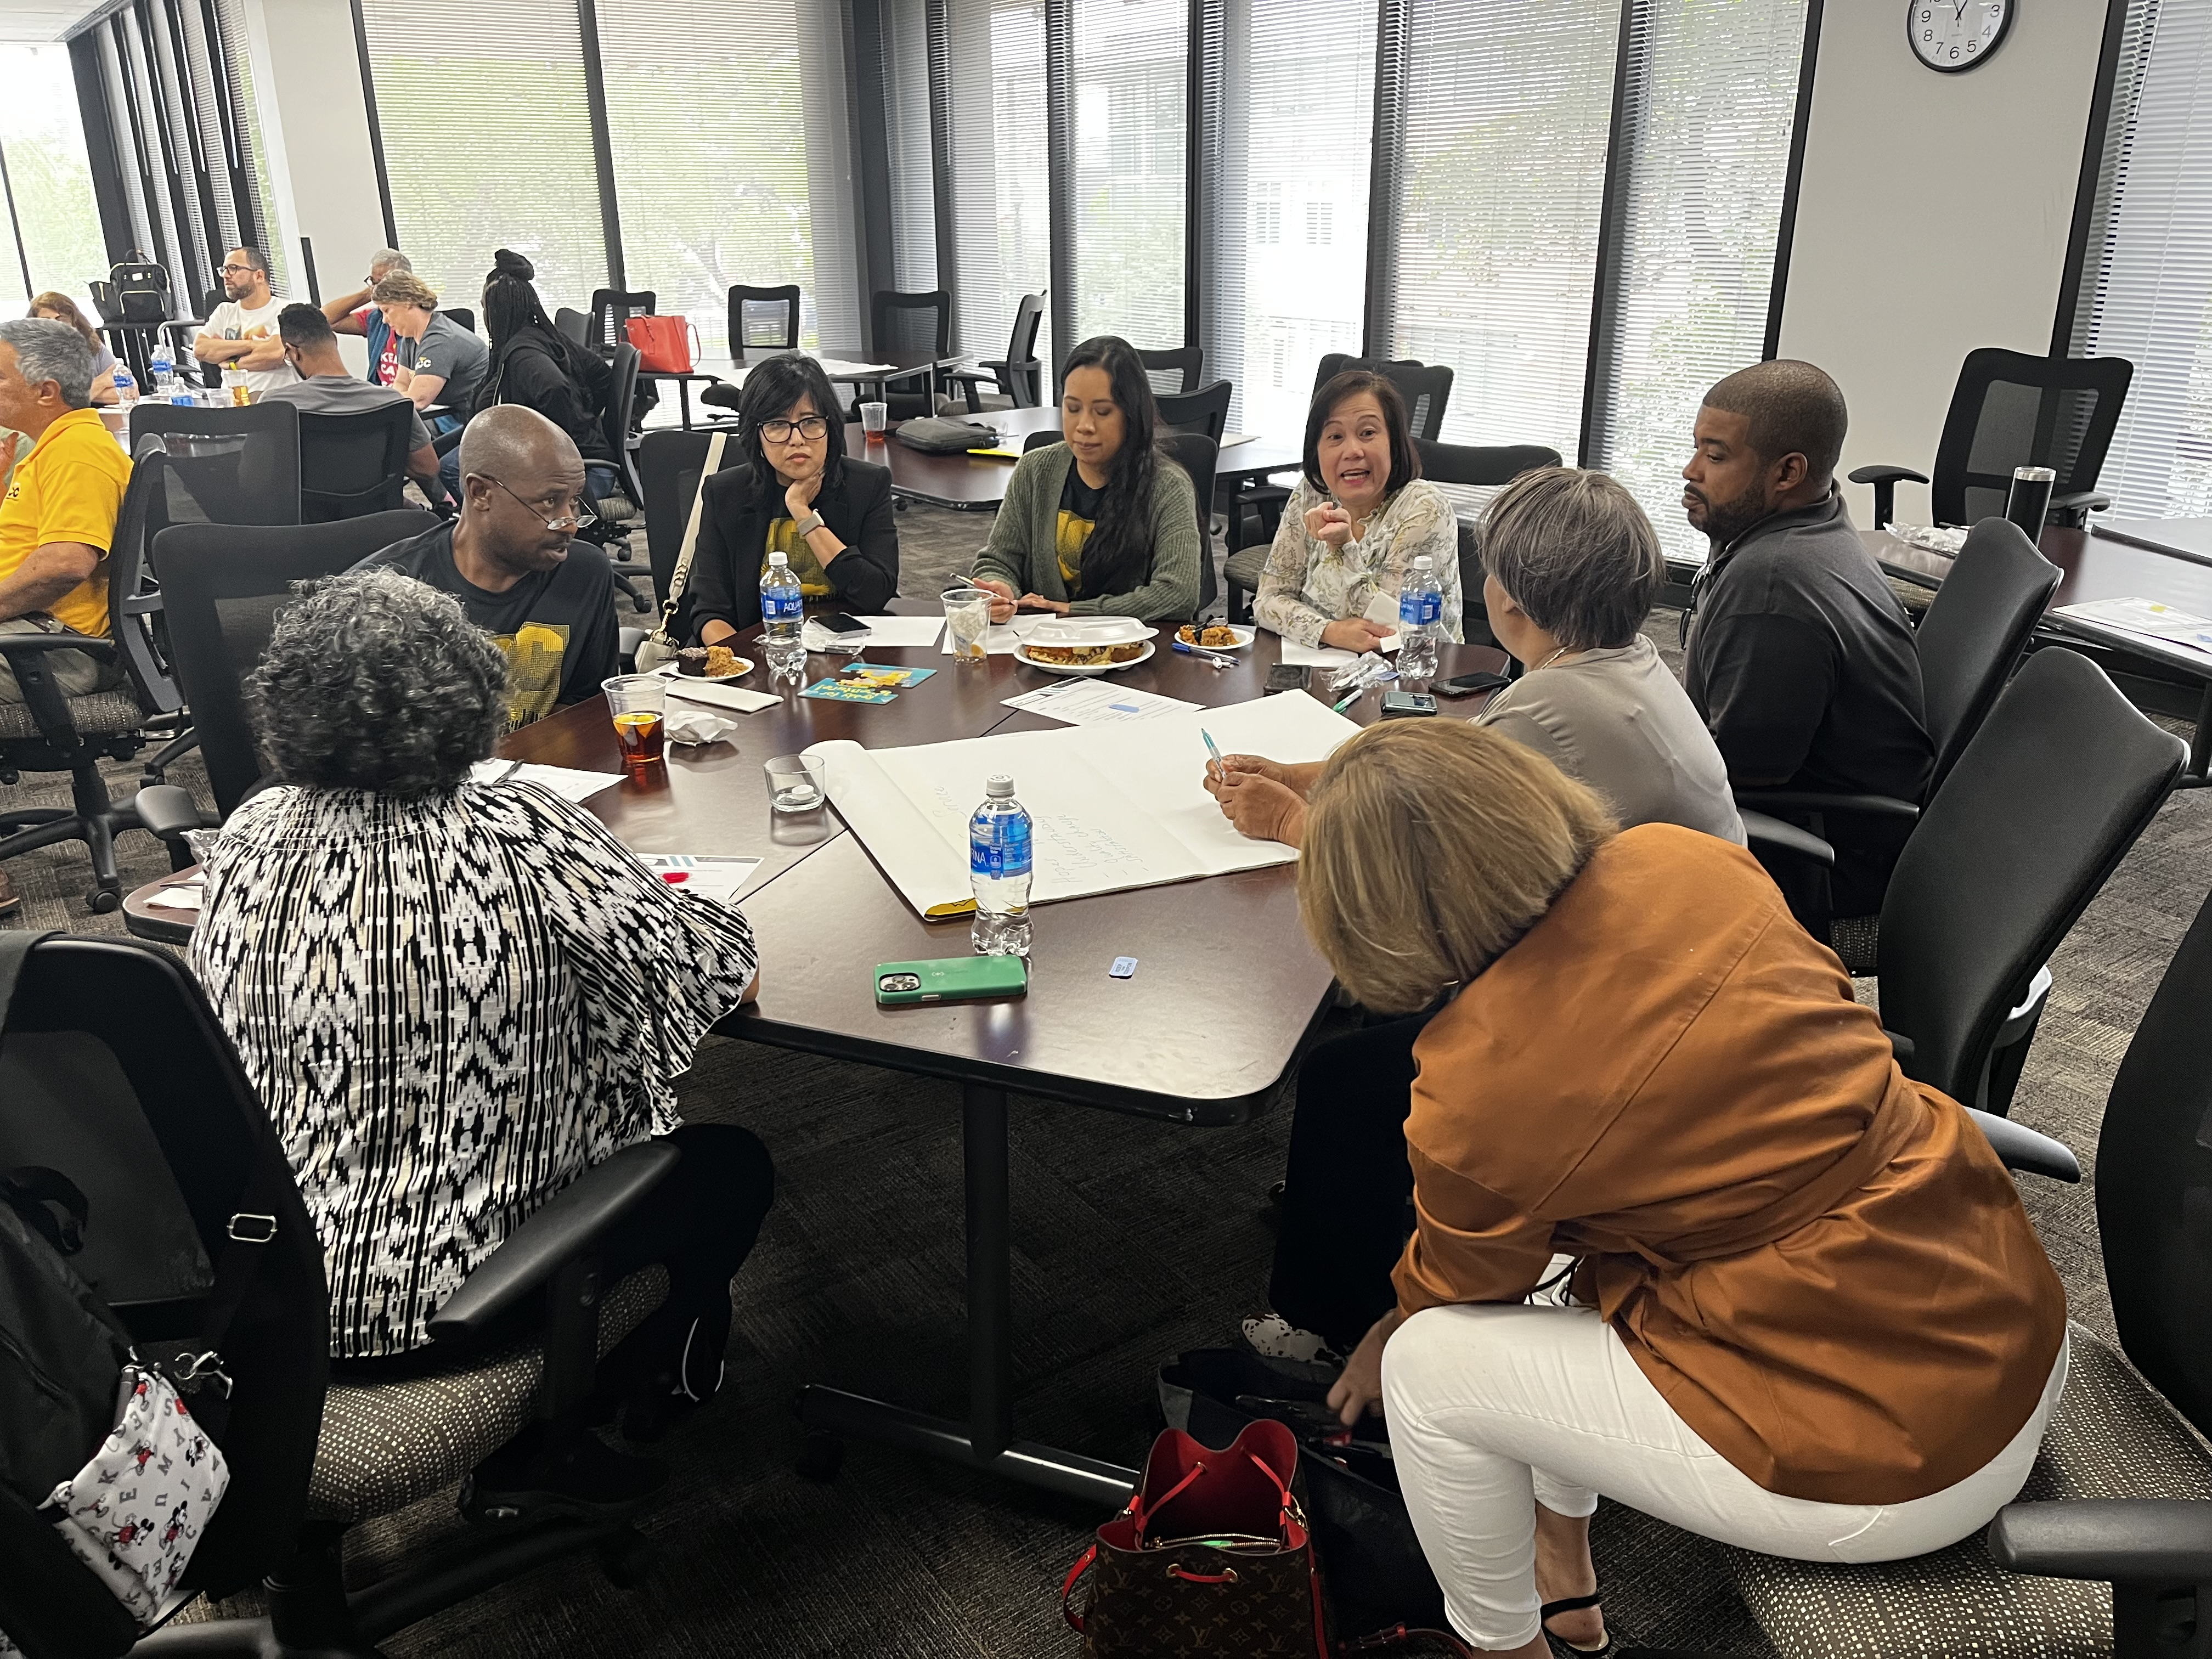
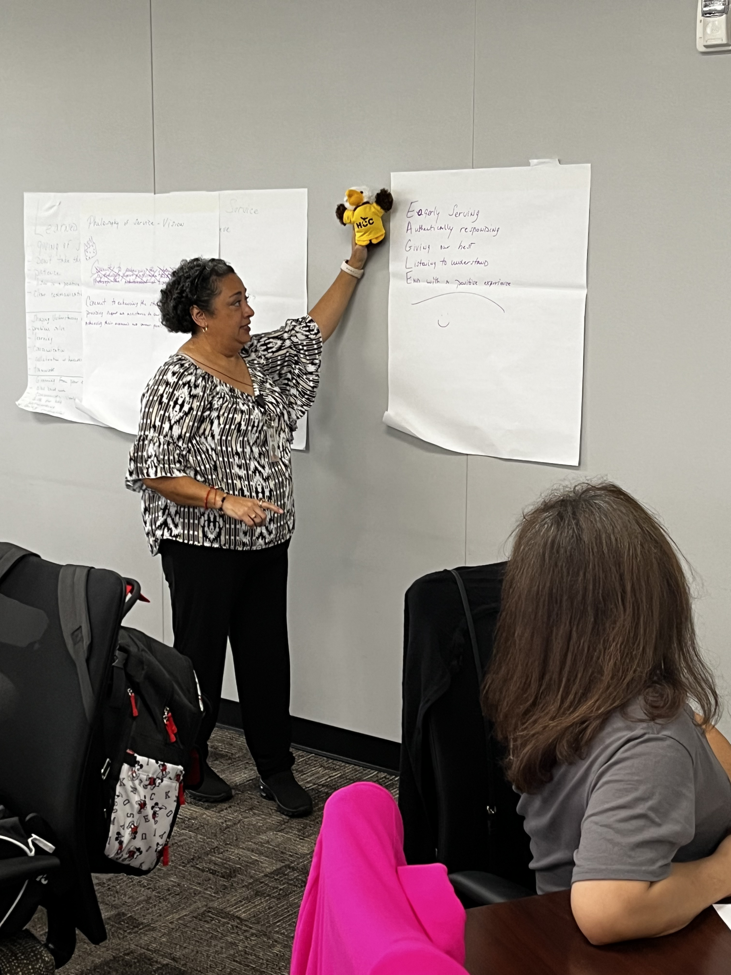
District Student Services
Special Programs Division
Philosophy of Service
Celebrate student’ wins whether big or small inspiring an environment of support and success.
Address concerns timely with genuine care and intention for each student’s unique experience.
Remember the importance of our contributions to the success of every student we serve.
Eagerly serve students and colleagues with authenticity, kindness, and grace.

Slide 13
Online College
Philosophy of Service
Assist a demographically diverse student population to create a successful path or plan towards their educational and career goals.
Be a premiere institution providing attainable education regardless of your educational goals.
To provide a centralized vision with the highest ability of trained and committed service that will enhance, empower and enrich the academic success of students.

Slide 14
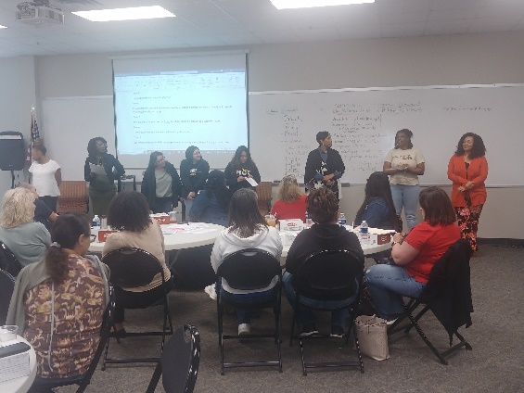
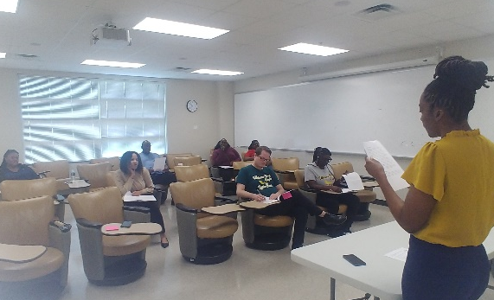
Central College
Philosophy of Service
Houston Community College…where inclusivity, innovation, commitment to community service, and student success thrive.

Slide 15
Northeast College
Philosophy of Service
Service is the relationship between an agent and a client in
which the agent offers specific expertise and abilities to help
clients achieve their academic, professional, and personal
goals. Understanding the unique demands of internal and
external stakeholders requires empathy, understanding,
diversity, and inclusion. Effective communication, time
management, upholding a standard of professionalism, and
ongoing process review are other requirements for providing
service.
Our principles as student service experts include offering
effective assistance that results in favorable outcomes. To
ensure that information assists in a rational and consistent
resolution, it is crucial for agents to maintain openness with
their clients and give ethical deliverables. Experiences have
taught us that clients are unique and should all be treated fairly
and given the same standard of care.

Slide 16
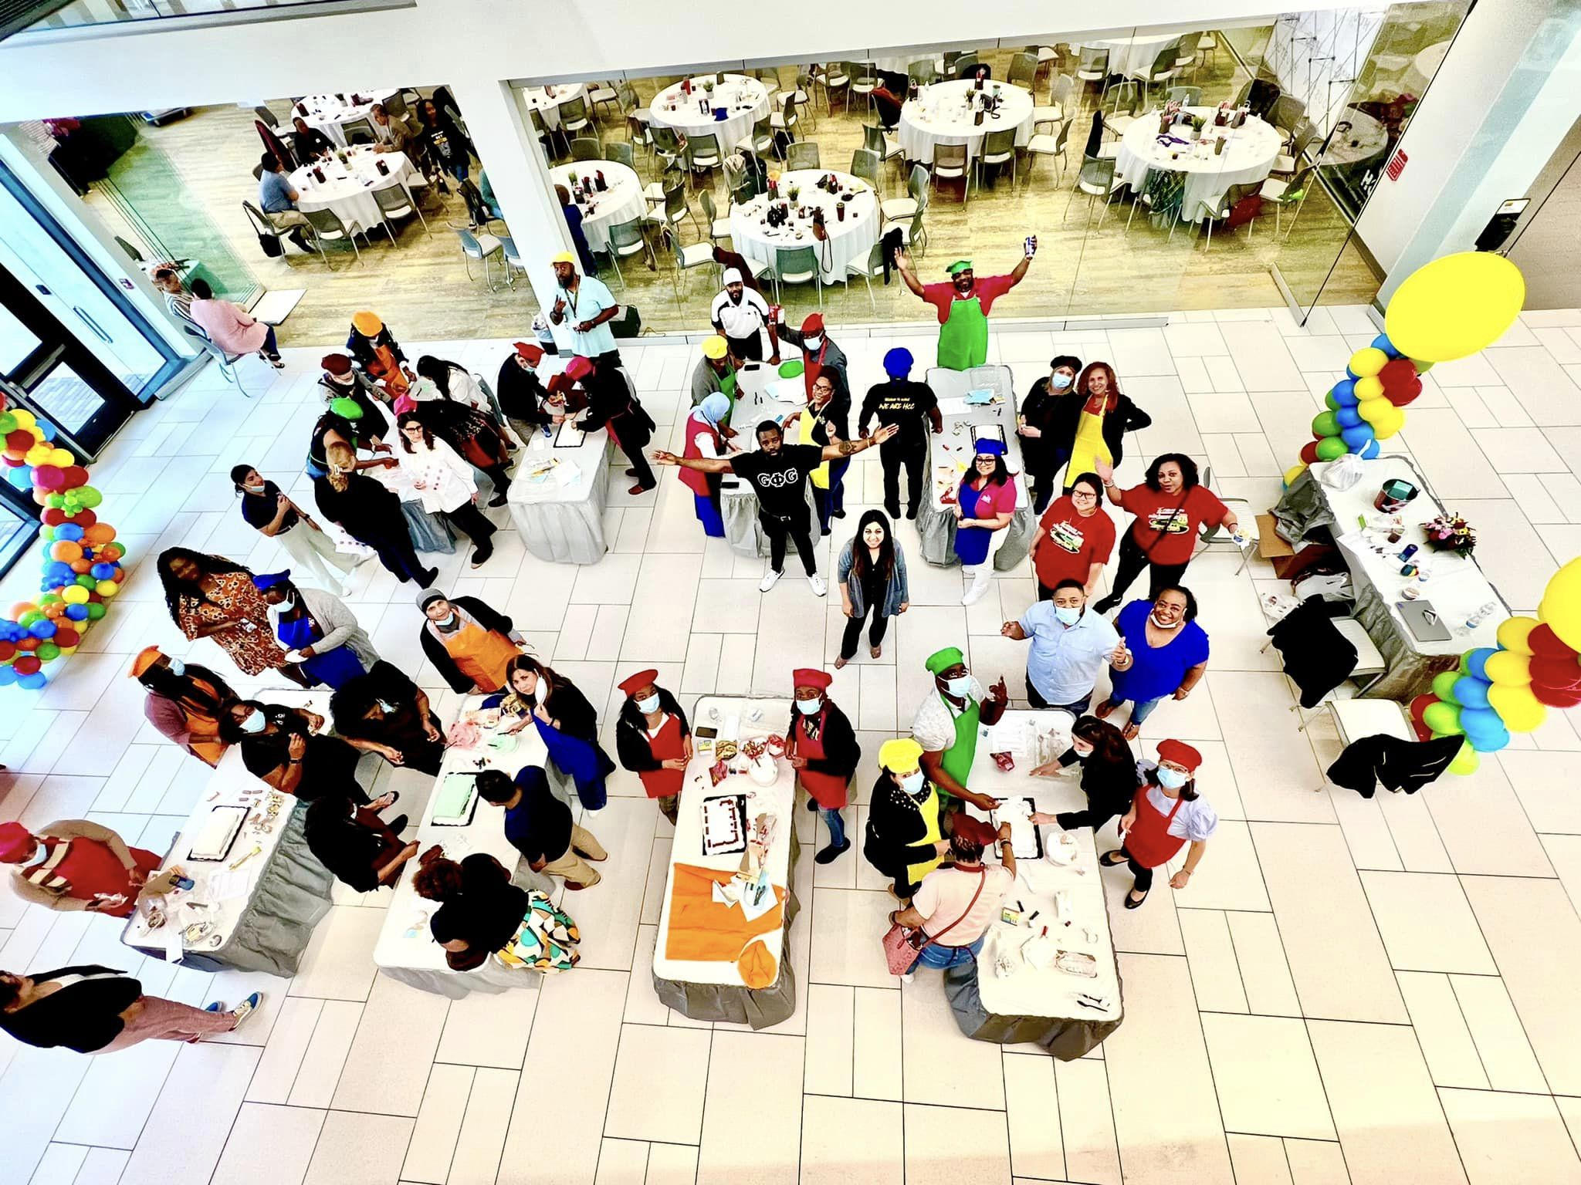

Northwest College
Philosophy of Service
HCCS Eagles
Helping Community Connect Successfully with Education, Access, Guidance, and Life Enhancing Skills

Slide 17
Our philosophy of service is grounded in the belief that service is not a one-time action but something we do day in and day out for the betterment of students by setting and using HCC principles to help them solve and support our students’ issues. Ensuring we have directed and guided them to a clear situation.
Southwest College
Philosophy of Service

Slide 18
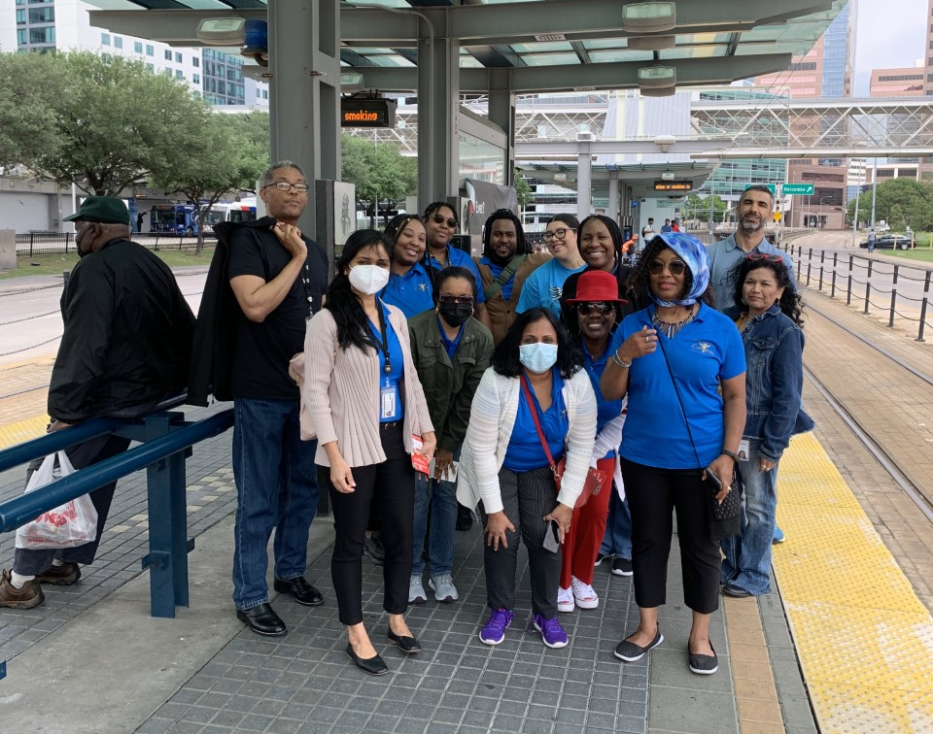
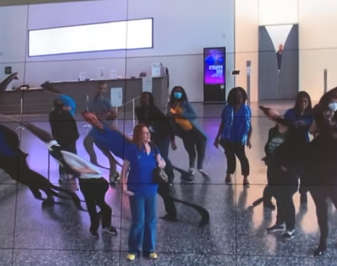
To establish an environment that priorities the well-being and goals of its constituents by adopting a holistic service approach that emphasizes culture of empathy, responsiveness, trust, and positive relationships.
Coleman College
Philosophy of Service

Slide 19
Table Discussion (10 mins)
First Round –
Individually - Read each philosophy statement and rank the statements from 1 to 8 with (8) being most impactful and (1) being the least.
With your team - Discuss your choices at your table. Create one ranking list for your table.
Notes:
Share reflections from how your customer service experiences in your group, shape how you provide service.
What were some of the goals of service your group identified?
Let’s hear your philosophy.

Slide 20
Table Discussion (10 mins)
Second Round –
With your team, Take the top 4 statements on your ranked list and merge the best of each into one statement.

Slide 21
Third Round – Report Out (5 mins)
Share your new philosophy statement and any important themes that emerged.

Slide 22
Thank You!
Notes:
Next steps with philosophy of service work
Thank you again for the work you do!

